Slide 1
Back-End Component Vulnerabilities
Cybersecurity
Lesson 14.2

Slide 2

Class Objectives
By the end of today’s lesson, you will be able to:
1
Differentiate between front-end and back-end component vulnerabilities.
2
View confidential files with a directory traversal attack by using the dot-dot-slash method.
3
Exploit a web application’s file upload functionality to conduct a local file inclusion attack.
4
Modify a web application’s URL to use a malicious remote script to conduct three different remote file inclusion attacks.

Slide 3

Intro to Back-End
Component Vulnerabilities

Slide 5

Web vulnerabilities
are weaknesses that exist
within the intended purposes
of a web application.
Malicious actors can exploit
these web vulnerabilities
to cause unintended consequences.

Slide 6
The OWASP Top 10: Injection
AO1
Broken Access Control
AO6
Vulnerable and Outdated Components
AO2
Cryptographic Failures
AO7
Identification and Authentication Failures
AO3
Injection
AO8
Software and Data Integrity Failures
AO4
Insecure Design
AO9
Security Logging and Monitoring Failures
AO5
Security Misconfiguration
A10
Server-Side Request Forgery (SSRF)

Slide 7

Recap: Injection
Injection is a specific type of attack that occurs when an attacker supplies untrusted input to an application.
The payload is processed as part
of a query or command that alters
the intended functionality of
a program.

Slide 8

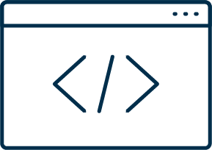

Review: Injection Types
There are various types of injection depending on the architecture and functionality
of the application.
Cross-Site Scripting (XSS)
SQL Injection
Conducted by an attacker inserting malicious JavaScript into a web application.
Depends on the application modifying the client-side code with a user’s input.
Conducted by an attacker inserting malicious SQL statements into
a web application.
Depends on the application running queries against
a SQL database.

Slide 9




Review: Cross-Site Scripting (XSS)
The types of XSS include:
Reflected (Non-Persistent) XSS
Stored (Persistent) XSS
Depends on the user input being immediately returned to the user and not stored on the application’s server.
Depends on the user input being stored on the application’s server and later retrieved by a user accessing the web application.
Website
Website
Attacker
User
Attacker
User

Slide 10
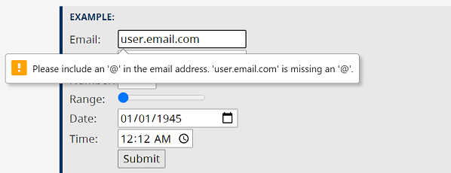
Review: Input Validation
Input validation is a method used to validate the data input with a predefined
logic to ensure that the input is what the application is expecting.

Slide 11
Back-End Component Vulnerabilities

Slide 12



Last Lesson
In the last lesson, we covered JavaScript and HTML cross-site scripting vulnerabilities.
These languages are considered front-end components, as they form the part of the
web application that the user interacts with, typically with a browser.
Another front-end component is Cascading Style Sheets (CSS), which formats the layout of the HTML.

Slide 13
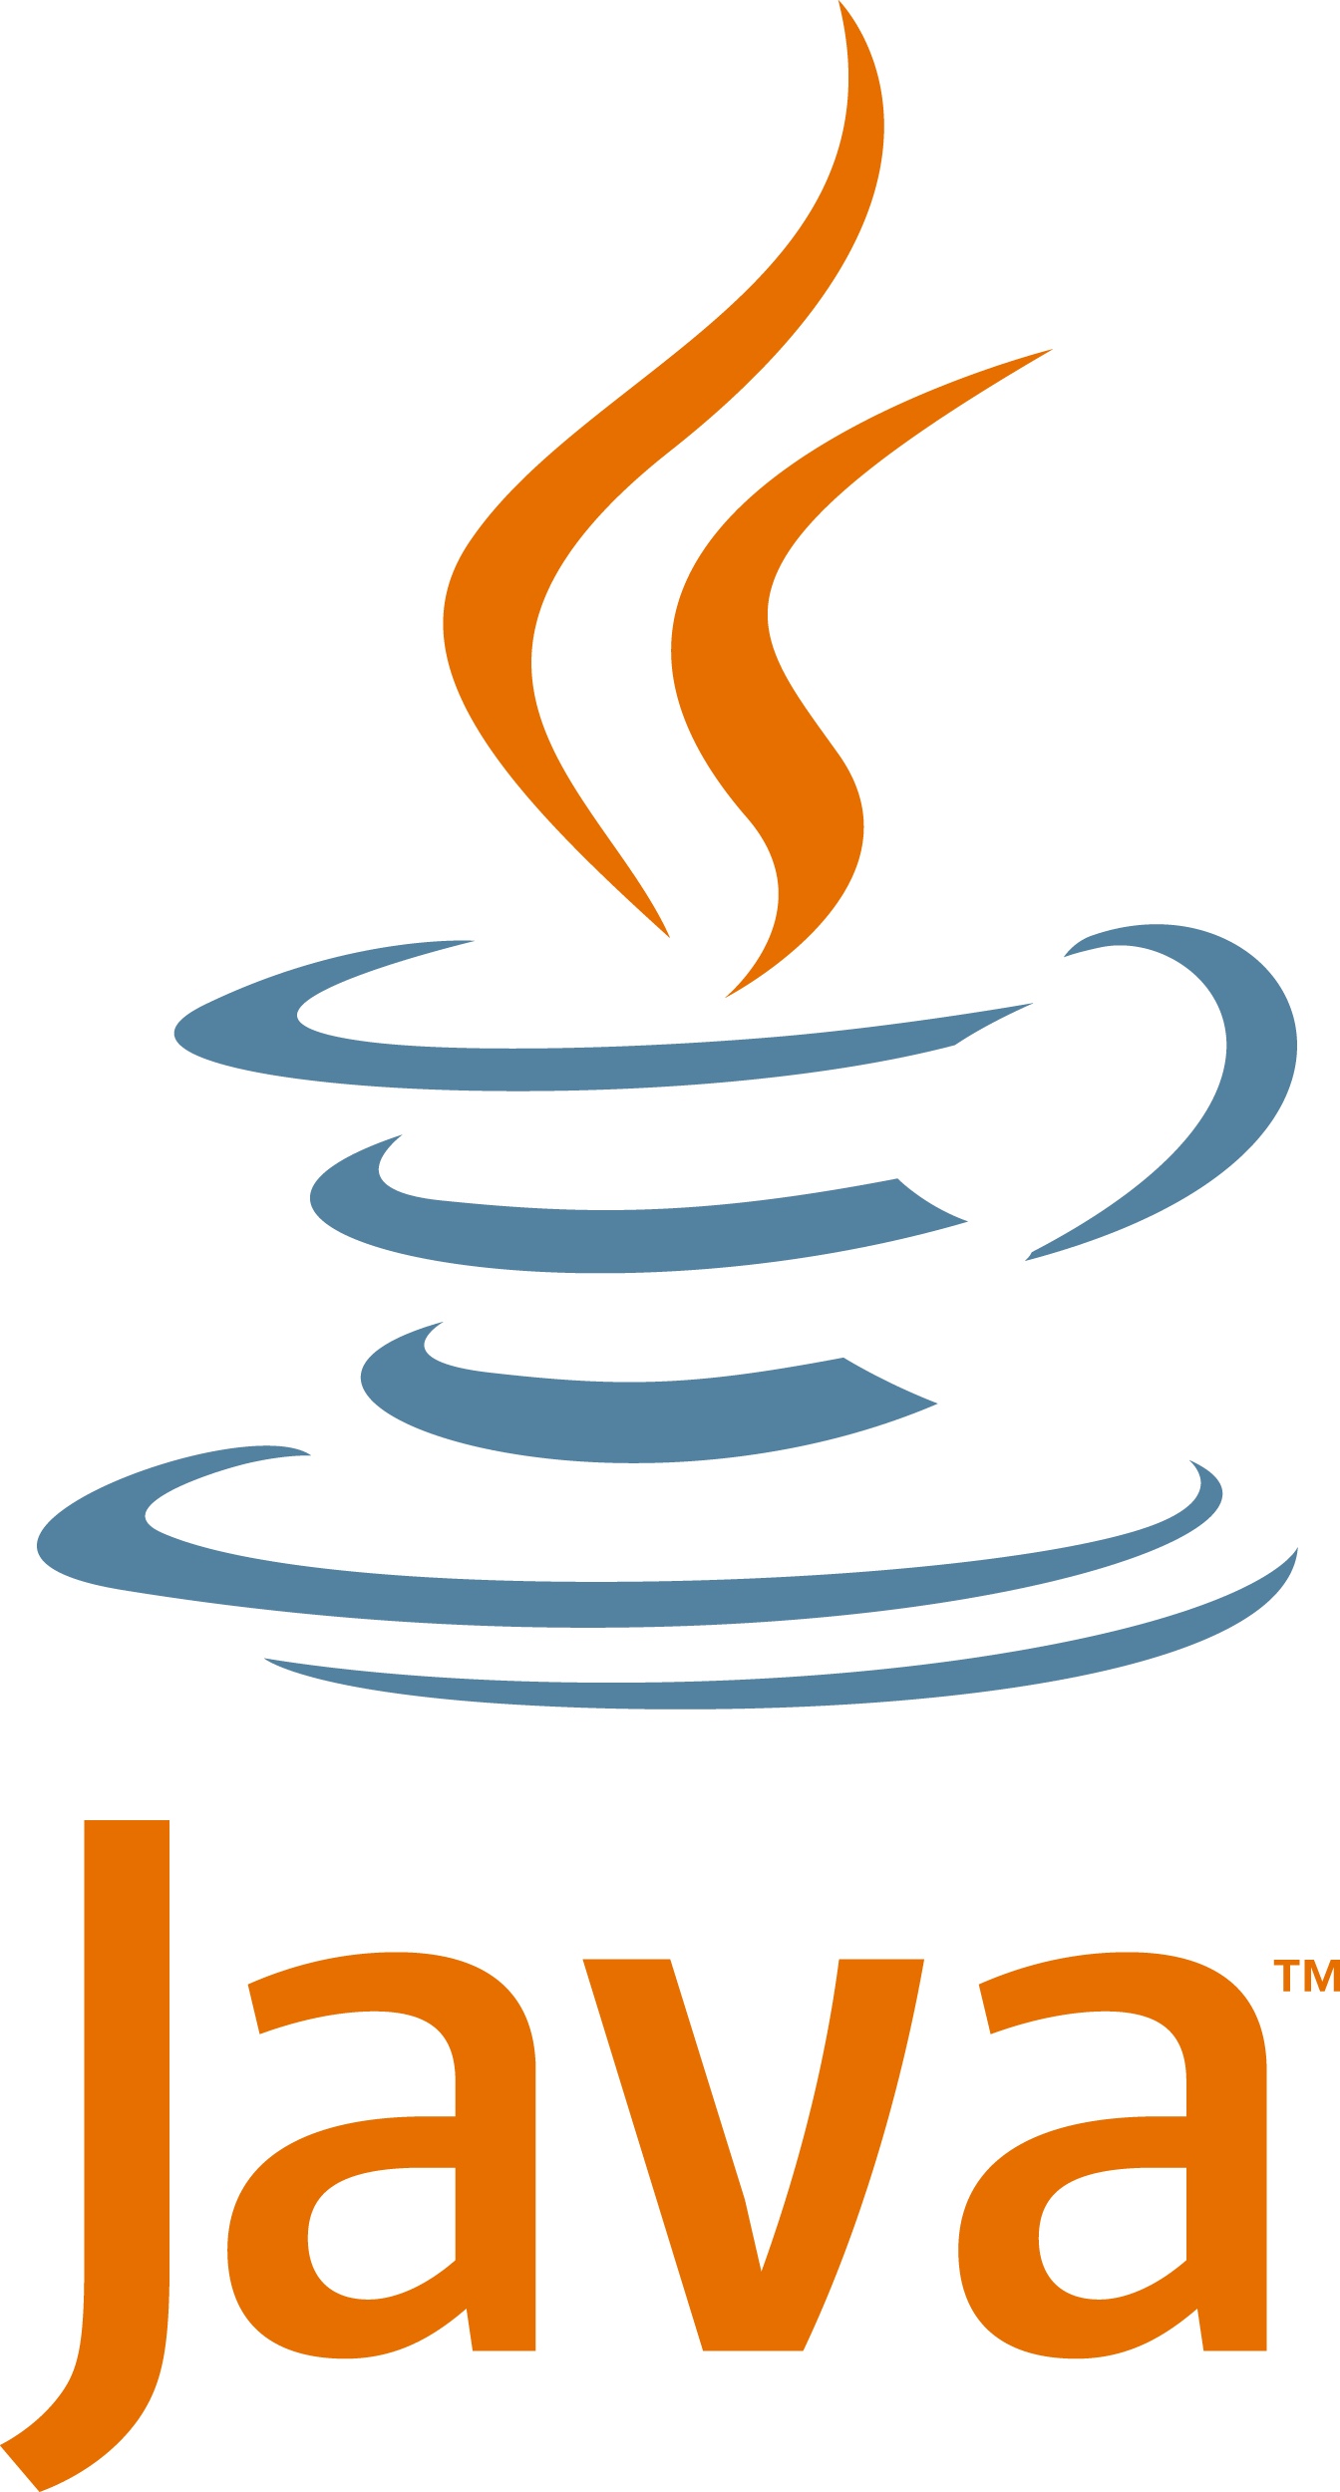

Today’s Lesson
We will focus on vulnerabilities that can exist within back-end components.
These components apply the business logic of how the application works, including:
File structure
Back-end languages include PHP and Java.
Content management
Access control

Slide 14

Vulnerabilities in back-end components could potentially allow a malicious actor
to access or display confidential files or documents that exist on an organization’s private server.
Notes:
shutterstock_408907717

Slide 15
Vulnerabilities: Intended Purpose
An intended purpose of an application involves a user accessing a webpage and displaying prices of several products at an online store. The query that retrieves the product prices is the applied business logic.
BodgIt Store
+
>
<
https://www.bodgitstore/products
The BodgeIt Store
We bodge it, so you don’t have to!
Welcome, Xavier!
About Us
Contact Us
Login
Products
Search
Doodahs
Gizmos
Thingamajigs
Thingies
Whatchamacallits
Whatsits
Widgets
Our Best Deals
Product | Type | Price
TGJ CCC | Thingamajigs | $0.70
Complex Widget | Gizmos | $1.00
Weird Widget | Whatchamacallits | $4.32
Whatsit taste like | Whatsits | $3.96
Whatnot | Whatchamacallits | $2.68
Whatnot | Whatchamacallits | $2.68

Slide 16
Vulnerabilities: Unintended Consequence
A malicious actor has changed the URL to access confidential files, such
as employee salaries, which are NOT intended to be displayed to users.
BodgIt Store
+
>
<
https://www.bodgitstore/salary_data
The BodgeIt Store
We bodge it, so you don’t have to!
Welcome, Xavier!
About Us
Contact Us
Login
Products
Search
Company Salaries
Confidential
Name | Title | Annual salary
Sally Smith | CEO | $1.2 million
Julie Jones | SVP | $400,000
Tom Roberts | VP | $150,000
Mike Allen | Supv | $80,000
Susan Johnson | Exec Asst | $75,000

Slide 17
Today’s Lesson
We will cover three attacks that exist within back-end component vulnerabilities:
First
Next
Finally
We will begin by demonstrating how
an attacker can use
a directory traversal attack to access
an organization’s confidential data.
We will learn how
an attacker can use
a common web application file
upload functionality
to conduct a local
file inclusion attack.
We will demonstrate another file inclusion attack, called a remote file inclusion attack,
in which an attacker
can reference remote malicious scripts
through the URL.

Slide 18
⚠️ Important ⚠️
The techniques we will learn throughout this unit can be used to cause serious damage to an organization’s systems.
This is ILLEGAL when done without permission. All of the labs that we provide are safe locations to test the methods and tools taught during the week.
NEVER apply any of these methods to any web applications that you do not own or do not have clear, written permission to be interacting with.

Slide 19
Directory Traversal

Slide 20
Directory traversal, also known
as path traversal, occurs when
an attacker accesses files and directories from a web application outside a user’s authorized permissions.

Slide 21


Directory Traversal
Using this attack, a malicious actor could access confidential business documents, source code, or critical system files that exist within an organization’s private server directly from a web application.
Directory traversal primarily falls under the OWASP Top 10 risk category broken access control.
Notes:
shutterstock_1734611708

Slide 22
The OWASP Top 10: Broken Access Control
AO1
Broken Access Control
AO6
Vulnerable and Outdated Components
AO2
Cryptographic Failures
AO7
Identification and Authentication Failures
AO3
Injection
AO8
Software and Data Integrity Failures
AO4
Insecure Design
AO9
Security Logging and Monitoring Failures
AO5
Security Misconfiguration
A10
Server-Side Request Forgery (SSRF)
Source: owasp.org

Slide 23
Per OWASP, broken access control is explained as follows:
Restrictions on what authenticated
users are allowed to do are often not properly enforced.
Attackers can exploit these flaws to access unauthorized functionality
and/or data, such as access other users’ accounts, view sensitive files, modify other users’ data, change access rights, etc.”
Source: owasp.org

Slide 24
Understanding Directory Traversal
We first need to understand what happens behind the scenes as an application interacts with the file structure of a web application.
We’ll cover the following:
01
The intended purpose of the web application.
02
How the application accesses files and directories from a web server.
03
The modification of the URL to access unintended files.
04
The traversal of directories to access additional unintended files with the dot-dot-slash method.

Slide 25
Directory traversal

Slide 26

Real-World Challenges,
Impact, and Mitigations

Slide 27
Access to Filesystem Structure
The demo illustrated how modifying a URL with the dot-dot-slash method can cause unintended results.
In our demonstration…
For example:
If ../../../etc/passwd doesn’t display the contents, we can try to keep adding the dot-dot-slashes until the file is displayed:
../../../etc/passwd
../../../../etc/passwd
../../../../../etc/passwd
We were able to preview back-end systems to display the file structures.
But in the real world…
Application security analysts would likely not have access to the filesystems.

Slide 28
Variety of Confidential Files and Data
While the demonstration involved one file “/etc/passwd,” many other system files
or documents might exist that are not intended to be viewed by an attacker, such as:
/etc/group | To view information on groups that exist on the server.
/etc/hosts | To view information on how IPs are mapped to hostnames.

Slide 29

Impact
The impact of directory traversal attacks include allowing malicious actors to do the following:
View an organization’s confidential data.
View an organization’s system files
to determine
other vulnerabilities.
Help an attacker launch other attacks.

Slide 30
Mitigation Methods
Because a directory traversal attack is conducted by using the dot-dot-slash method to modify user input like the URL, methods to mitigate this attack include:
1
Limiting user input when calling for files from the web application.
2
Using input validation to limit the user’s ability to modify the file.
3
Running web servers under a special service user account.

Slide 31
Directory Traversal Summary
Intended purpose of original function | A web application interacts with its web server to access intended files.
Vulnerability and method of exploit | With the directory traversal attack, a user can modify the user input using a dot-dot-slash method to access unintended files in other directories.
Unintended consequence of the exploit | Confidential documents or system files can be accessed directly from the web application by a malicious user.
Mitigation of the vulnerability | Mitigation includes applying input validation code logic or limiting user input when calling for system files.
Potential impact of the exploit | The impact could include unauthorized parties accessing an organization’s confidential data within its servers. This unauthorized data could be used to launch other attacks.

Slide 33

Directory traversal
In this activity, you’ll continue to play the role of an application
security analyst at Replicants, inspecting the company’s web
application for web vulnerabilities, specifically directory traversal.
20 minutes

Slide 37
Web Application Back-End Code

Slide 38

Web Application Back-End Code
Web applications use back-end components to apply business logic to the application. Back-end components can provide file structure, content management, and access control, and include back-end languages such as PHP and Java.
Web application vulnerabilities can exist within back-end components.

Slide 39
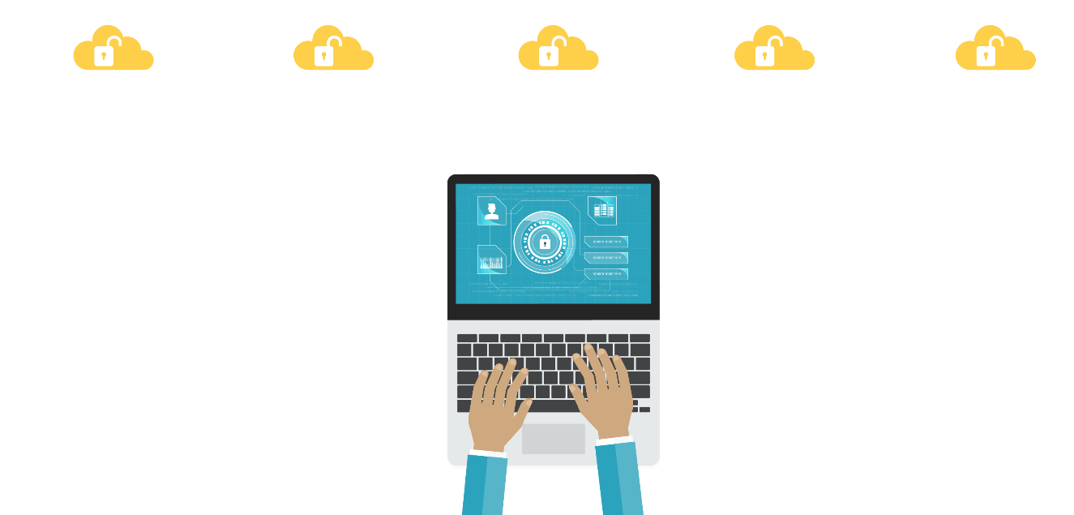
Directory Traversal Has Limited Impact
Directory traversal is a back-end component vulnerability in which an
attacker accesses files and directories from a web application outside
a user’s authorized permissions.
NOTE: While directory traversal is a back-end component vulnerability that can cause significant impact, the direct impact is limited to
an attacker viewing unauthorized data.
>_

Slide 40
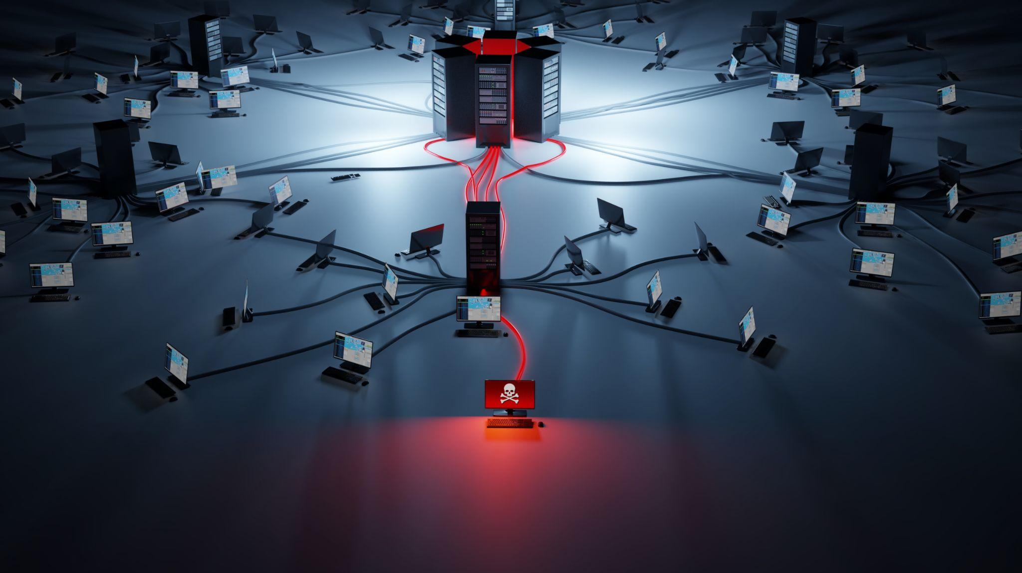
Another type of back-end component vulnerability is called local file inclusion (LFI).
LFI can let attackers view unauthorized data, impact the modification and deletion
of data, and cause system outages.
Notes:
shutterstock_1744222322

Slide 41
LFI is a web application vulnerability
in which an attacker tricks
the application into running unintended back-end code or scripts that are local
to the application’s filesystem.
(In other words, the scripts reside on the web application’s server.)

Slide 42

LFI
LFI is typically conducted by using a file upload feature to upload malicious scripts into the application’s local filesystem. Common examples of file upload web applications include:
Uploading your resume for
an online job listing.
Uploading and viewing images
on a social media website.

Slide 43
Depending on how the attack is conducted, LFI could fall under the following three OWASP Top 10 risks:
AO1
Broken Access Control
AO6
Vulnerable and Outdated Components
AO2
Cryptographic Failures
AO7
Identification and Authentication Failures
AO3
Injection
AO8
Software and Data Integrity Failures
AO4
Insecure Design
AO9
Security Logging and Monitoring Failures
AO5
Security Misconfiguration
A10
Server-Side Request Forgery (SSRF)

Slide 44
Before learning how to conduct an LFI exploit,
we need to review how a web application
runs back-end code like PHP.

Slide 45
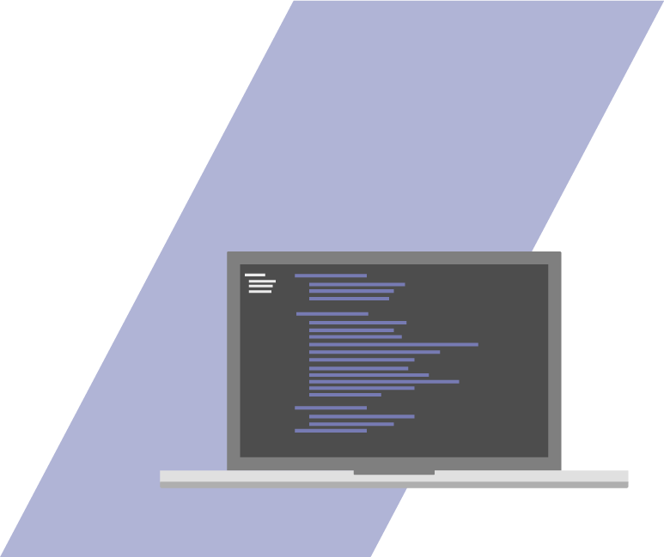
PHP
PHP stands for Hypertext Preprocessor.
PHP is a server-side language used to develop web applications.
PHP files have a .php file extension.
PHP is often used to do the following:
Connect to back-end databases such as MySQL
Create and work with
website cookies

Slide 46
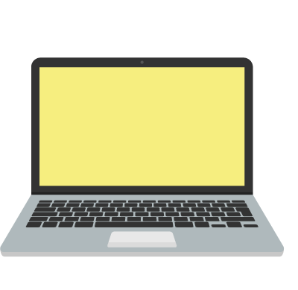
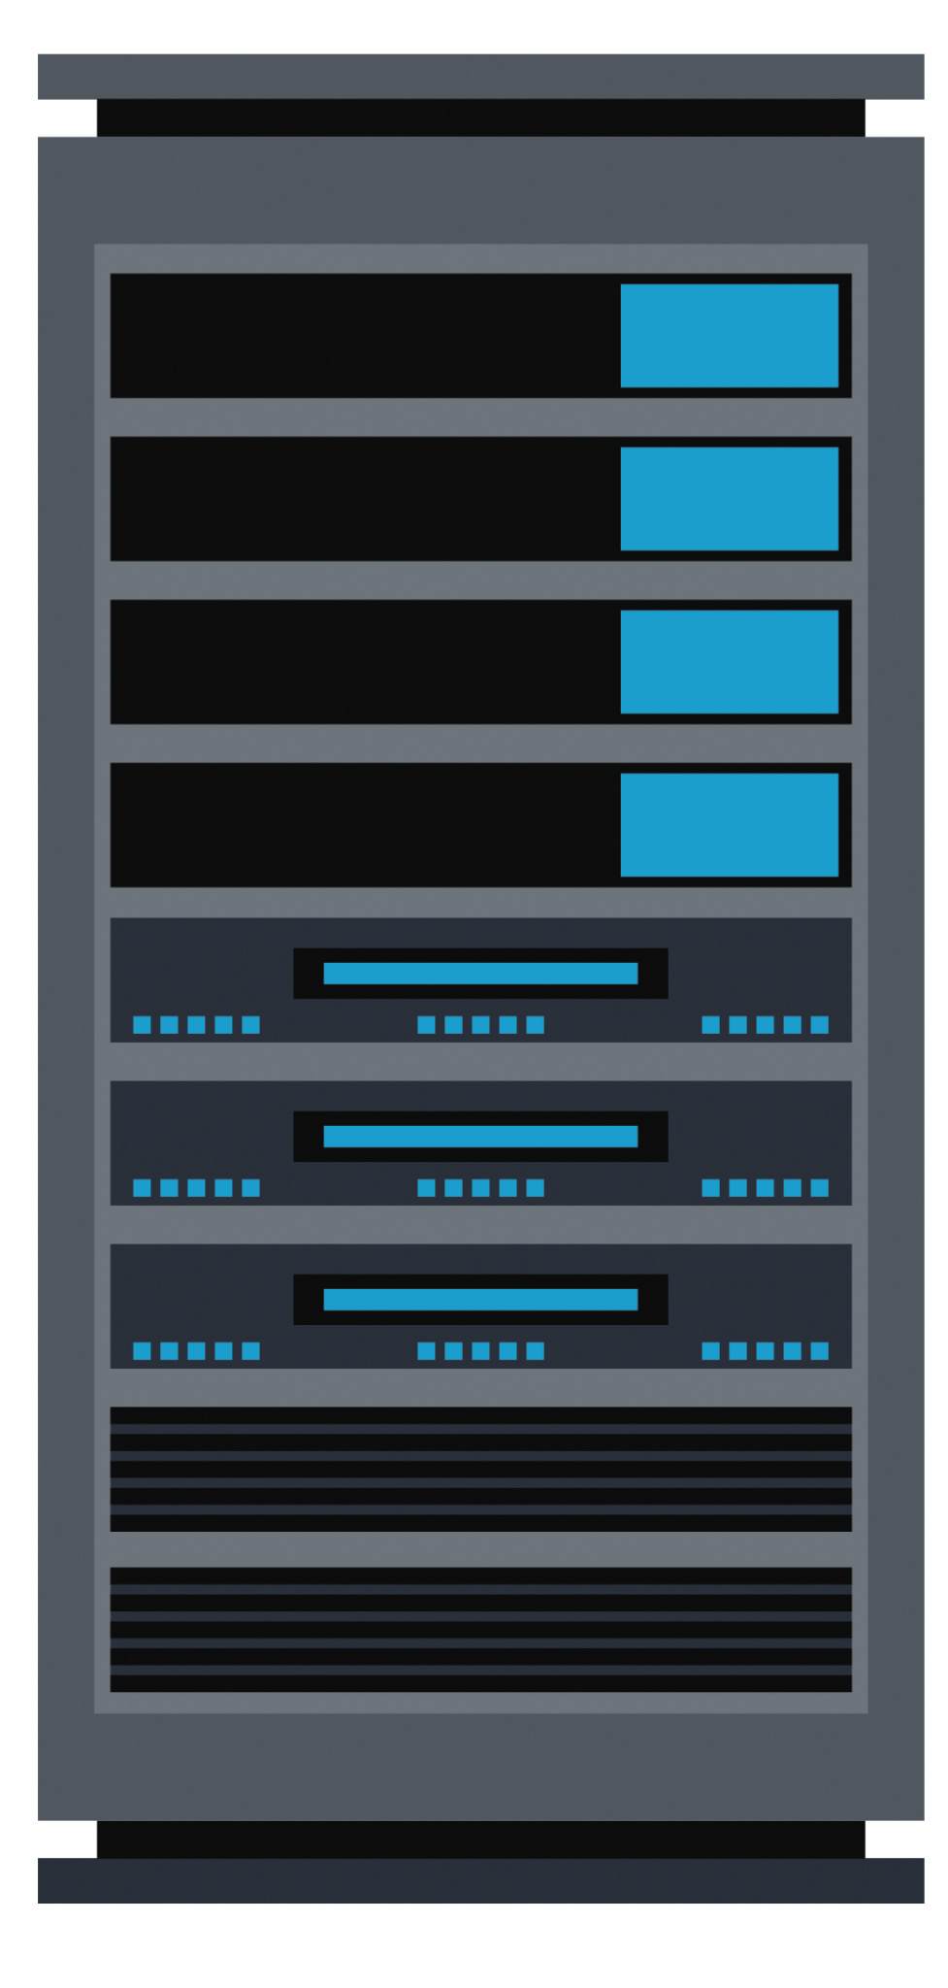
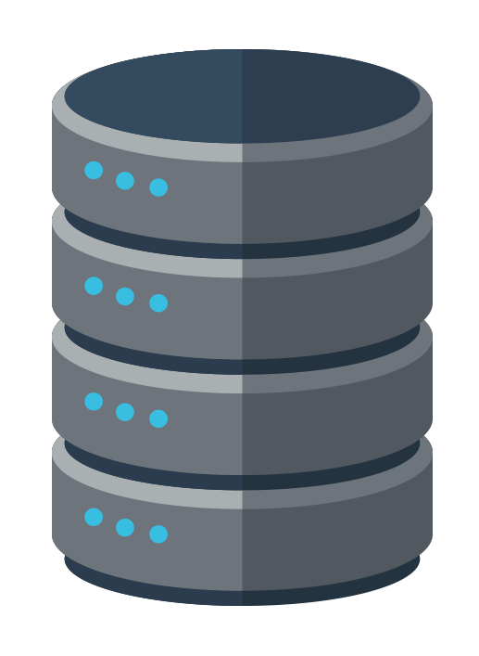
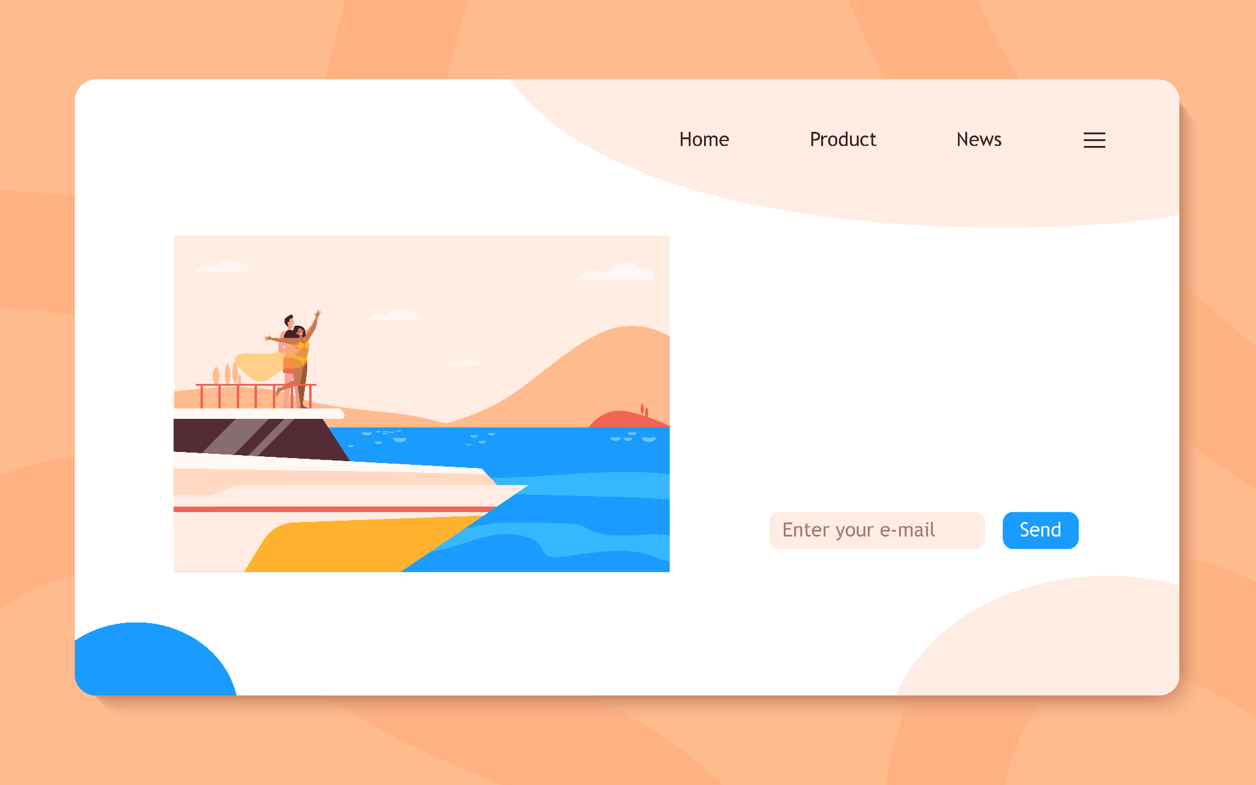
PHP Example
Suppose a user wants to display different types of boats at mycoolboat.com.
The different types of boats are stored in a database on MyCoolBoat’s servers.
01
A user visits their
favorite boating website: mycoolboat.com.
03
An HTTP request is made to the web server.
HTTP Request
My Cool Boat
Web Server
MyCoolBoat Database
02
While on mycoolboat.com, the user clicks
a shopping link to redirect to a .php webpage (mycoolboat.com/shopping.php) where boats
for sale are displayed.
04
The web server for mycoolboat.com pre-processes the PHP scripts to request the list of boats from MyCoolBoat’s database.

Slide 47
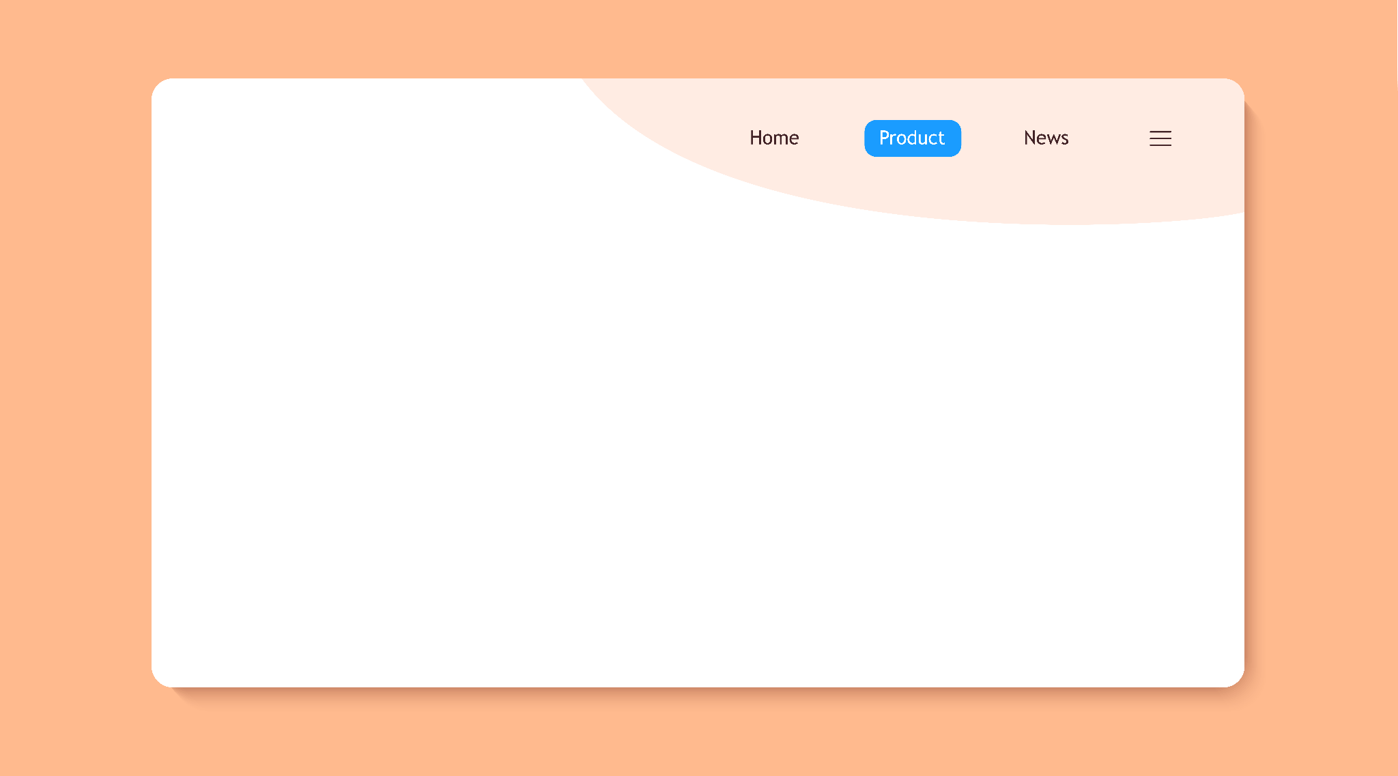
PHP Example
Suppose a user wants to display different types of boats at mycoolboat.com.
The different types of boats are stored in a database on MyCoolBoat’s servers.
The database returns the requested data
and the web server sends the processed HTML back to the user with an HTTP response.
05
Boats
for you
HTTP Response
Web Server
MyCoolBoat
Database
06
The user’s browser renders the HTML to display the list of boats to the user.

Slide 48
Takeaways
In the previous example:
1
The browser initiated a request to run the PHP script simply by accessing the page.
2
The PHP script exists and runs on the back-end server.
Now we know that PHP is a language that provides back-end functionality
to a webpage, let’s explore how LFI can use this functionality to cause unintended results.

Slide 49
Local File Inclusion

Slide 50

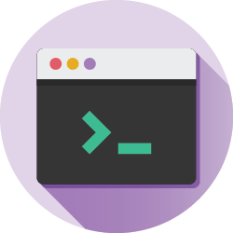

LFI Demonstration
In this demonstration, we will:
<script></script>
Illustrate
how a web application can use PHP and HTML together.
Show
the intended purpose
of a web application’s
file upload functionality.
Upload
a malicious PHP script.
Run
command-line commands with the malicious PHP script.

Slide 51
LFI

Slide 52
Demonstration Summary
The ability to successfully upload and run this script indicates that this web application is vulnerable to LFI.
1
We were able to include (upload) a file (script) locally, then run that unintended script.
2
This web application is also vulnerable to remote code execution (RCE).
3
RCE is a type of attack in which a malicious actor can execute arbitrary commands.

Slide 53
Real-World Challenges,
Impact, and Mitigations

Slide 54

Real-World Challenges
Injection involves submitting an untrusted input. How applications work with the input depends on their design, architecture, and functionality. We’ll focus on:
Our Demonstration
Our Attack Method
Illustrated using one type of malicious script and two command-line commands.
Thousands of malicious scripts can be uploaded and many malicious commands can be run.
Used the PHP language, but this attack can also be accomplished with other languages, such as ASP.
Notes:
AdobeStock_102792357 shutterstock_1177007617

Slide 55
Impact
If a malicious actor can upload a malicious script, they can potentially:
View confidential
files or data.
Modify or delete confidential files
or data.
Modify or delete
critical files to cause
system disruptions.

Slide 56


Mitigation Methods
The best way to protect from
LFI is to restrict users from
being able to upload files
into the local filesystem.
If the application requires file upload functionality,
then the application should use allow listing to ensure that only a specific file type (like .jpg) can be uploaded, and not script file types such as .php.
jpg
php

Slide 57
LFI Summary
Intended purpose of original function | Web applications use file upload functionalities to enable a user to upload files into their local filesystem.
Vulnerability and Method of exploit | LFI is a vulnerability in which a malicious user can use the file upload functionality to upload unintended scripts into the web server’s local filesystem.
Unintended consequence of the exploit | After the malicious script has been uploaded, a malicious user can run the script to cause unintended consequences.
Mitigation of the vulnerability | Limit file upload capabilities or use allow listing to restrict unintended file types.
Potential impact of the exploit | A malicious actor can access or modify confidential data or system files, or potentially cause system outages.

Slide 59
LFI
You will continue in the role of an application security analyst working for bioengineering company Replicants.
In this activity, you’ll inspect Replicants’ main production website for LFI vulnerabilities.
20 minutes

Slide 60
Notes:
09. Instructor Review: Local File Inclusion Activity (0:10)

Slide 62
Remote File Inclusion

Slide 63
Remote File Inclusion
So far we’ve covered:
Directory Traversal
LFI
A back-end component vulnerability in which an attacker accesses files and directories from a web application outside a user’s authorized permissions.
Another back-end component vulnerability in which an attacker tricks the application into running unintended back-end code or scripts that are LOCAL to the application’s filesystem.
LFI depends on allowing a user to use unintended scripts that are LOCAL to the web server.
Notes:
AdobeStock_102792357 shutterstock_1177007617

Slide 64

An application preventing malicious users from adding files to their local system does not guarantee that it
is protected from an attacker running unintended back-end code or scripts.
Notes:
shutterstock_411816985

Slide 65

Another type of
back-end component vulnerability called
remote file inclusion (RFI) involves using remote files or scripts to conduct
a similar attack.
Notes:
shutterstock_1024337071

Slide 66
RFI is a web application vulnerability in which an attacker tricks the application into running unintended back-end code
or scripts that are remote to
the application’s filesystem.
(In other words, the scripts DO NOT reside on the web application’s server.)

Slide 67

RFI is typically conducted by modifying the parameter
of a URL to point to
a remote script.
Notes:
shutterstock_2081950246

Slide 68
Depending on how the attack is conducted, RFI could fall under the following three OWASP Top 10 risks:
AO1
Broken Access Control
AO6
Vulnerable and Outdated Components
AO2
Cryptographic Failures
AO7
Identification and Authentication Failures
AO3
Injection
AO8
Software and Data Integrity Failures
AO4
Insecure Design
AO9
Security Logging and Monitoring Failures
AO5
Security Misconfiguration
A10
Server-Side Request Forgery (SSRF)

Slide 69
RFI Demonstration
In this demonstration, we will conduct the following three steps:
1
Revisit how a web application uses parameters as intended.
2
Modify the parameters to point to a remote site to cause unintended consequences.
3
Modify the URL to run this remote malicious PHP script.

Slide 70
RFI

Slide 71
Demo Summary
The ability to successfully change the parameter of the URL to point to a remote script and then subsequently running this script indicates that this web application is vulnerable to RFI.
The ability to arbitrarily execute command-line code with the remote script means this web application is also vulnerable to RCE.
../../hackable/uploads/image.jpg successfully uploaded!

Slide 72
Real-World Challenges,
Impact, and Mitigations

Slide 73
Real-World Challenges
Limitation of the RFI Attack
Variety of Attacks
To conduct this attack successfully, the web server must run PHP and also needs to enable a configuration setting to allow external URLs.
Many web servers that run PHP do not have this configuration enabled.
The demonstration illustrated using one type of malicious script and two command-line commands.
Thousands of malicious scripts can be uploaded and many malicious commands can be run.
The attack method used the PHP language, but this attack can also be accomplished with other languages, such as ASP.
Notes:
AdobeStock_102792357 shutterstock_1177007617

Slide 74
Impact
If a malicious actor can remotely access a malicious script, they can:
View confidential
files or data.
Modify or delete confidential files
or data.
Modify or delete
critical files to cause
system disruptions.

Slide 75
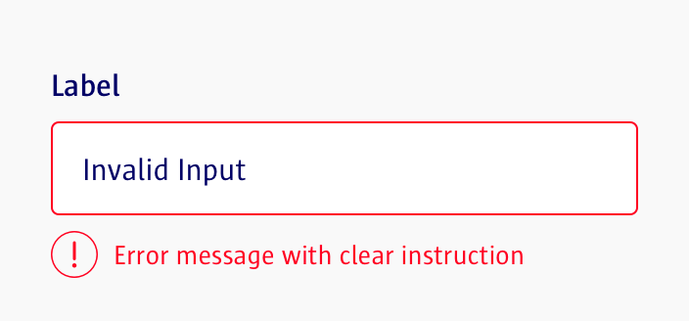
Mitigation Methods
The best way to protect from RFI is to avoid passing user-submitted input
to your web server. This can be accomplished by using input validation.

Slide 76
RFI Summary
Intended purpose of the original function | A web application can use parameters in its URL to indicate to the back-end server to access a certain resource.
Vulnerability and method of exploit | RFI is a vulnerability in which a malicious user can modify this parameter so that the back-end server accesses a malicious remote resource, such as a script.
Unintended consequence of the exploit | After the malicious remote script has been referenced, a malicious user can run the script to cause unintended consequences.
Mitigation of the vulnerability | Use input validation to avoid malicious submitted input, such as a modified parameter referencing a remote resource.
Potential impact of the exploit | A malicious actor can view or modify confidential data or system files, or potentially cause system outages.

Slide 77

Recap Back-End Components
Both of these attacks use back-end components of a web server to run unintended scripts, but they have some differences:
Local file inclusion scripts are local to the target server.
Remote file inclusion scripts are remote to the target server.

Slide 79
RFI
In this activity, you will test Replicants’ main production website for RFI vulnerabilities.
20 minutes

Slide 80
Notes:
12. Instructor Review: Remote File Inclusion Activity (0:10)

